Slide 1
Chapter One
Event Driven Fundamentals

Slide 2
Contents
Outline:
Event driven programming basics
Working in the programming environment
Using the intrinsic controls
Working with properties, methods, and events
Working with projects in event driven programming

Slide 3
What is event driven programing [1] ?
It is a programming paradigm in which the flow of the program is determined by events.
It is the dominant paradigm used in graphical user interfaces (GUI) and other applications (e.g., JavaScript web applications) that are centered on performing certain actions in response to user input.
An event act as a trigger to make the program to do something.
Events: are user actions such as (mouse clicks, key presses), sensor outputs, or message passing from other programs or threads.

Slide 4
What is event driven programing [2] ?
In an event-driven application, there is generally a main loop that listens for events and then triggers a callback function when one of those events is detected.
In embedded systems, the same may be achieved using hardware interrupts instead of a constantly running main loop.
Event-driven programs can be developed using different programming language such as C#, Visual Basic, Java, JavaScript etc.
Event-driven programming, is a paradigm where entities (objects, services, and so on) communicate indirectly by sending messages to one another through an intermediary.

Slide 5
Key features of event driven program
Form: is a container which group together all the controls(objects)which a user can use.
Controls: are objects on the form that can have events. Such as button, menu, text field etc.
Event loops: is a program which is built into a programming language to keep checking to find out if an event has occurred.
Trigger functions: used by event loops to identify which code run when a particular event happens.
Event handler: piece of code to be tun when a particular trigger has occurred.
NB: when a form is opened event loop will be run as a background process of every application. And when we click on a given control of a form, trigger function will be invoked and identify which code to be run. (event handler)

Slide 6
Working with programming environment
Programming environment is a working platform which combines hardware and software that allows a developer to build applications.
An integrated development environment (IDE) (also known as integrated design environment or integrated debugging environment) is a software application that provides comprehensive facilities to computer programmers for software development.
An IDE normally consists of:
a source code editor
a compiler and/or an interpreter
build automation tools
a debugger
Sometimes a version control system and various tools are integrated to simplify the construction of a GUI.
Many modern IDEs also have a class browser, an object inspector, and a class hierarchy diagram, for use with object-oriented software development.

Slide 7
……visual studio 2012
C# and visual studio
C# is the programming language, while Microsoft Visual Studio is the development environment.
It is used to develop console and graphical user interface applications along with Windows Forms applications, web sites, web applications, and web services.
C# is an object-oriented programming language provided by Microsoft that runs on both .NET standards called .NET core and .NET framework.

Slide 8
……visual studio 2012
C# and visual studio
Microsoft visual studio shares a single integrated development environment (IDE) that is composed of several elements:
It consists of:
The solution explorer
Server explorer
Properties window
Standard toolbar (tool box)
The Menu bar
Various tool windows docked or auto-hidden on the left, bottom, and right sides, as well as the editor space

Slide 9
Solution explorer
Solutions and projects contain items that represent the references, data connections, folders, and files that you need to create your application.
A solution container can contain multiple projects
See on the next slide

Slide 10
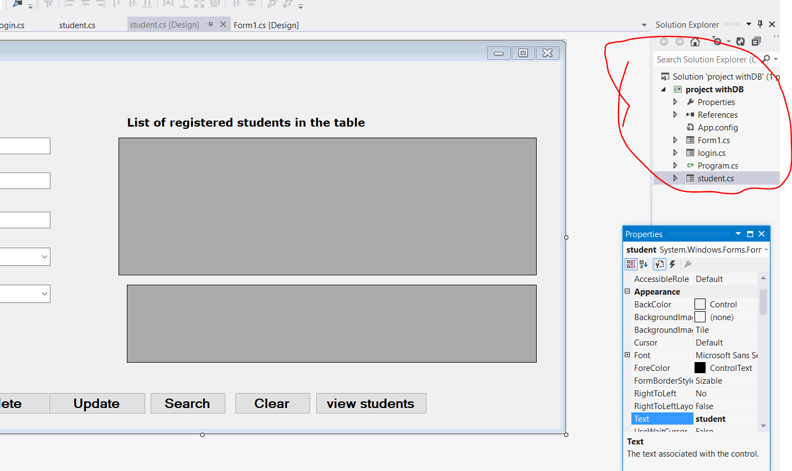
Solution explorer

Slide 11
Toolbox
Toolbox contains all the necessary controls for our user interface like Button, Textbox, Checkbox e.tc.
You need to create your user interface and we can add the required control by dragging and dropping from the toolbox to our form.
see on the next slide

Slide 12
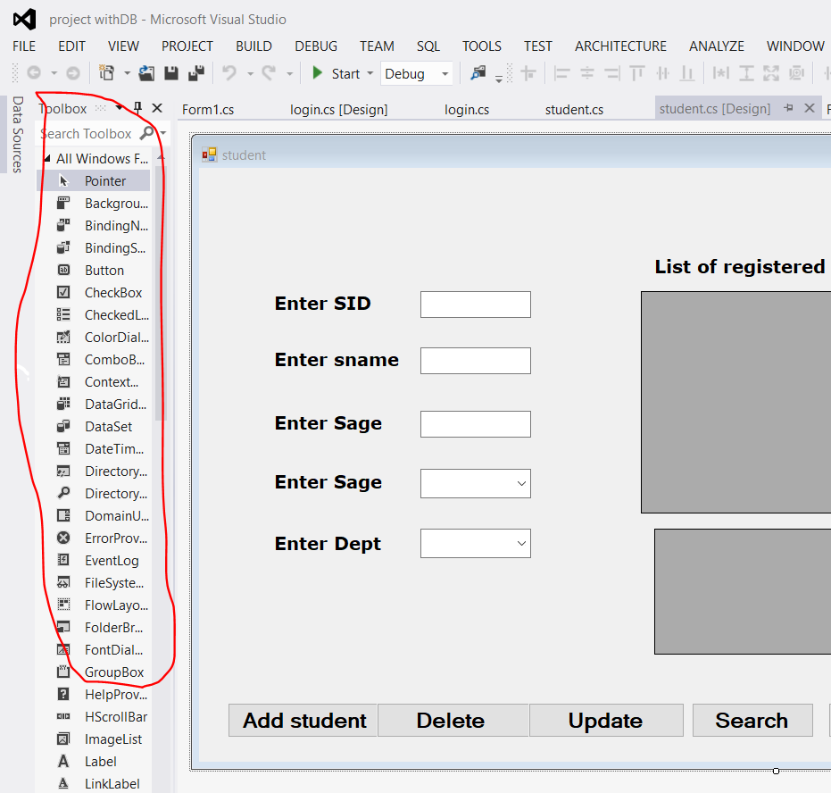
Toolbox cont’d
Wh

Slide 13
Controls

Slide 14
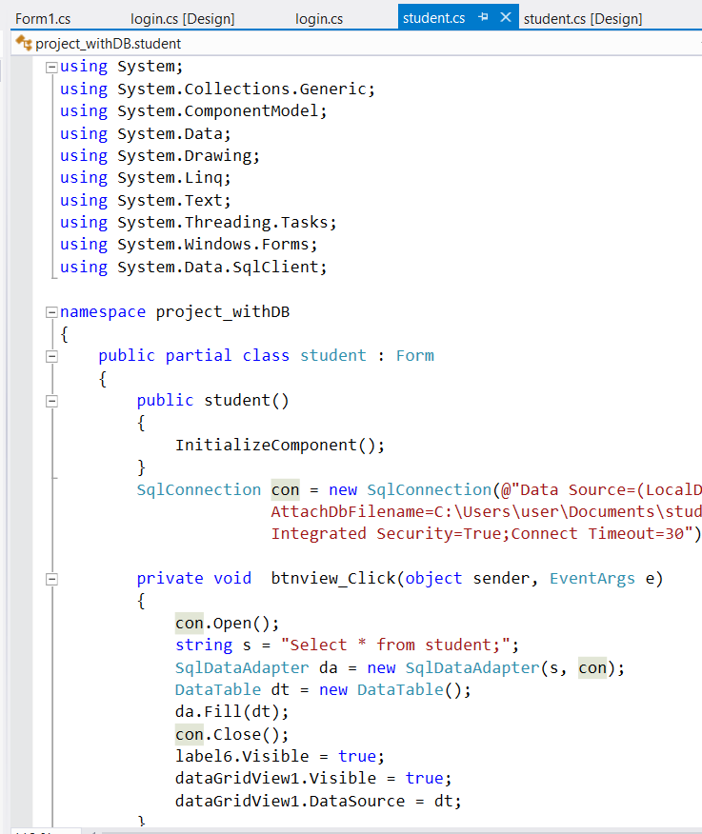
C# Code editor

Slide 15
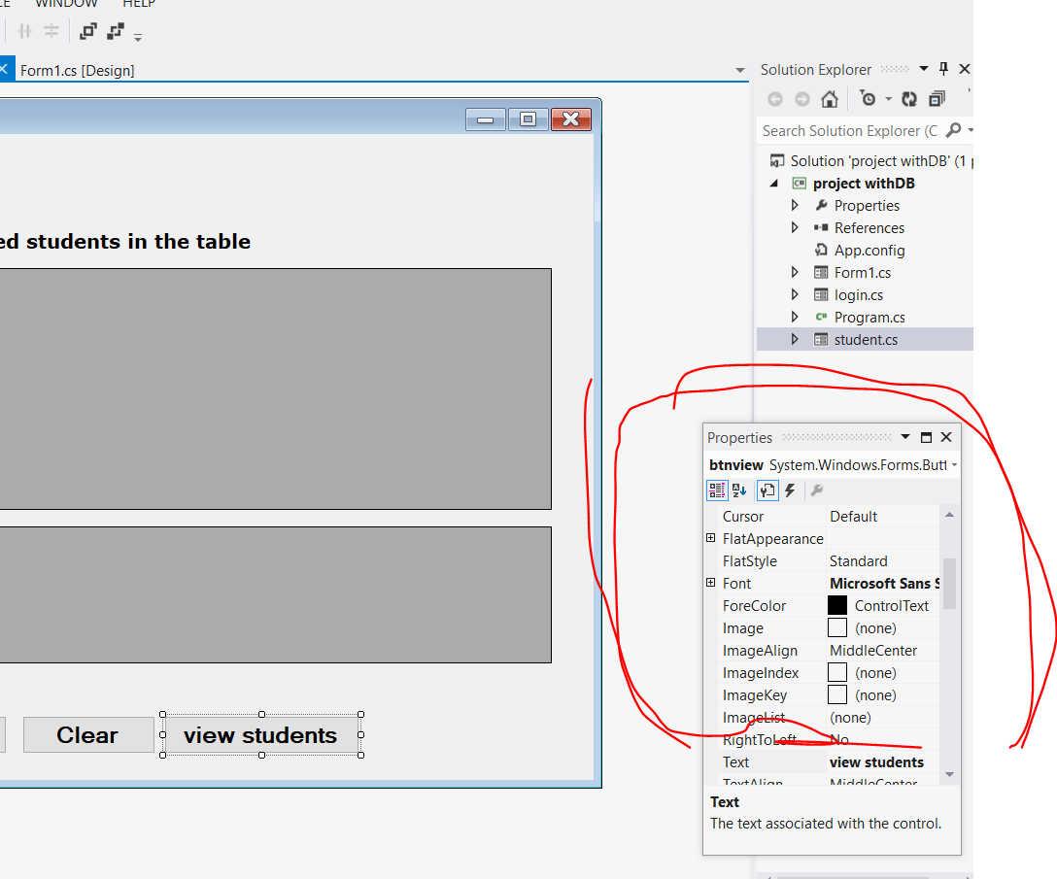
Properties window
On our user interface each control has lots of Properties which can set.
This helps to use attributes of controls (as CSS in HTML)

Slide 16
Intrinsic controls
In C#, forms are the foundations you generally use to build a programs.
A form is where you put all the things that people interact with as they use your program.
Those things you put on the form are controls, such as enter text and click buttons, select menu, check box, radio button……
Intrinsic controls: are controls which are visible at the tool box on the visual studio.
Controls which are not visible on toolbox are called extrinsic controls.

Slide 17
Methods
Methods are a bit like verbs. They tell objects to do something, such as play and stop.
In some cases, methods can be used to simplify the setting of properties. You might use a method called setSize(), for example, to simultaneously set the width and height of something.
Other methods are more unique, such as navigateToURL(), which instructs a browser to display a web page.

Slide 18
Methods
A method is a member of a class which we’ll use to define some functionality.
Methods allow you to modularize an app by separating its tasks into reusable units.
Motivations for modularizing an app with methods
Software reuse—existing methods can be used as building blocks to create new apps.
Avoid repeating code.
Making programs easier to test, debug and maintain
Dividing an application into meaningful methods makes the app easier to debug and maintain.
A method is an action that has to be performed.

Slide 19
Methods….Cont’d
Syntax for declaration of a Method:
[<modifiers>] <type> <name> ([parameter definition])
{ //Statements }
// [parameter definition] is optional
Modifier: Includes special keyword that can be used on a method like public, private, static, protected, virtual, abstract, override etc.
Type: used to specify the type of value it is going to return.

Slide 20
Methods….Cont’d
Parameter: If required, we can pass parameters to a method.
There are two types
Input parameters- used for brining a value into a method for execution
Output parameters- used for carrying a value out of the method for execution
We can send a value out of a method for execution in two different ways.
Using return types-carry only a single result out of the method
Using output parameters- are capable of carrying multiple value out of a method

Slide 21
Properties and Event of controls
You can apply different property attributes to all controls and perform a method when an event happen /occur
C# programming/procedure execution is highly performed using events.
Use demonstration forms by opening visual studio

Slide 22
Thank you!

